Slide 1
CS611 · ASSIGNMENT 2
Loan default prediction: building a leakage-safe data and feature pipeline
Bronze → Silver → Gold → split and EDA → automated feature engineering
Checklist V6.6, steps 01–23 · PySpark 3.5 · scikit-learn · OpenFE
October 2026
CS611 Assignment 2 · Loan default pipeline · Checklist V6.6 steps 01–23
1
Notes:
Scope: everything up to model development. Steps 01-23 of the V6.6 checklist. Models (steps 24-30) come next. The deck explains what was built and, more importantly, why each choice was made.

Slide 2
The pipeline at a glance
PART 1
PART 2
PART 3
PART 4
PART 5
Bronze EDA
Silver cleaning
Gold feature store
EDA to findings
Feature engineering
Ingest as-is, audit, profile
Schema, validate, clean, verify
As-of joins, labels, acceptance
Split, target EDA, actions
AutoFE, filtering, preprocessing
Steps 02–04
Steps 05–09
Steps 10–13
Steps 14–17
Steps 18–23
4
377,876
12,500
28.8%
68
3 / 3
raw sources
raw rows
loans, one per customer
default rate (30 DPD at month 6)
Gold features + 20 generated
quality gates passed
Principle throughout: anything that learns or chooses uses training data only; fixed formulas apply to every row; the out-of-time holdout stays untouched until the final test.
Code: developed in notebooks, converted to importable modules (util/*.py) with outputs verified identical; two orchestrator notebooks run the whole flow, and an Airflow DAG runs it month by month (back-fill 2023-01 → 2025-11), verified identical to the full build.
CS611 Assignment 2 · Loan default pipeline · Checklist V6.6 steps 01–23
2
Notes:
Five parts, each ending in a checked output. Key numbers: 4 sources, ~378k raw rows, 12,500 loans with a 28.8% default rate. Gates 1-3 passed. Emphasise the train-only principle - it drives most decisions.

Slide 3
Step 01: a signed prediction contract drives every layer
STEP 01
Field | Value
Entity / grain | loan_id, one row per loan
Scoring time | loan_start_date (at application)
Target | 30+ days past due at month-on-book 6
Horizon / eligibility | 6 months; mature labels only
Feature rule | latest snapshot on or before loan start
Not allowed | loan ledger (contains the outcome), Name, SSN
Version | v1.1.0: derived features declared
Why a contract
One source of truth: sources, keys, target and allowed predictors are read from YAML by every layer, not re-typed in code. Changing it means a new version and a new sign-off.
17 contract tests
Structure, sources, derived features, predictor rules and data checks, including a deliberately future-dated row that must never be picked.
CS611 Assignment 2 · Loan default pipeline · Checklist V6.6 steps 01–23
3
Notes:
The contract answers: what do we predict, for which unit, at what moment, with which data. Lab convention for the label: DPD computed from missed instalments; label = DPD >= 30 at MOB 6. check_predictors() rejects any column not available at scoring time.

Slide 4
PART 1
Bronze EDA
Ingest the raw files exactly as received, prove the load is complete and repeatable, then profile the raw data. Bronze is never cleaned.
Steps 02–04
CS611 Assignment 2 · Loan default pipeline · Checklist V6.6 steps 01–23
4

Slide 5
Steps 02–03: complete, repeatable raw load
STEPS 02–03
Source | Rows | Snapshots | Range
lms_loan_daily | 137,500 | 35 | 2023-01 → 2025-11
feature_clickstream | 215,376 | 24 | 2023-01 → 2024-12
features_attributes | 12,500 | 25 | 2023-01 → 2025-01
features_financials | 12,500 | 25 | 2023-01 → 2025-01
33
3
audit checks PASS
WARN: freshness
Audit warnings explained
Features end 2024-12 (clickstream) and 2025-01 (attributes, financials) while loans run to 2025-11.
Historical extract: the as-of rule takes each loan's latest snapshot on or before its start, so this is accepted, not an error.
Values unchanged: all columns stored as text plus lineage (source file, row number, batch, schema version).
Idempotent: file SHA-256 fingerprint skips unchanged files; changed files replace the table atomically. Rerun tests prove no duplicated loads.
Layout: one CSV per snapshot month (lab layout).
CS611 Assignment 2 · Loan default pipeline · Checklist V6.6 steps 01–23
5
Notes:
Nine audit checks per table: count and per-partition reconciliation, current-file check, freshness, missing months, null and duplicate keys, schema drift, column layout. Only freshness warns.

Slide 6
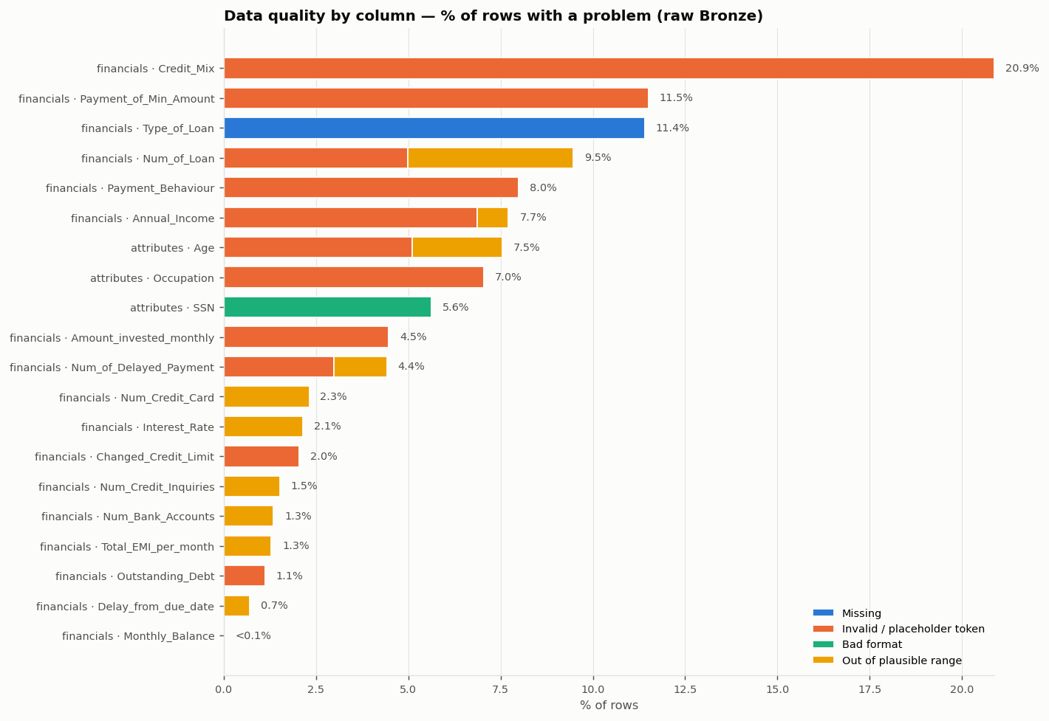
Step 04: 35 raw-data issues found, none fixed in Bronze
STEP 04
Worst column: Credit_Mix, 20.9% placeholder ‘_’.
Invalid tokens: trailing underscores (32_, 52312.68_) and codes like __10000__.
Findings only: each issue gets its decision later (Silver register).
CS611 Assignment 2 · Loan default pipeline · Checklist V6.6 steps 01–23
6
Notes:
Chart: share of rows with a problem per column, stacked by problem type. 35 issues: 11 high, 21 medium, 3 low. The register records findings only - the treatment is decided in Silver, as the checklist requires.

Slide 7
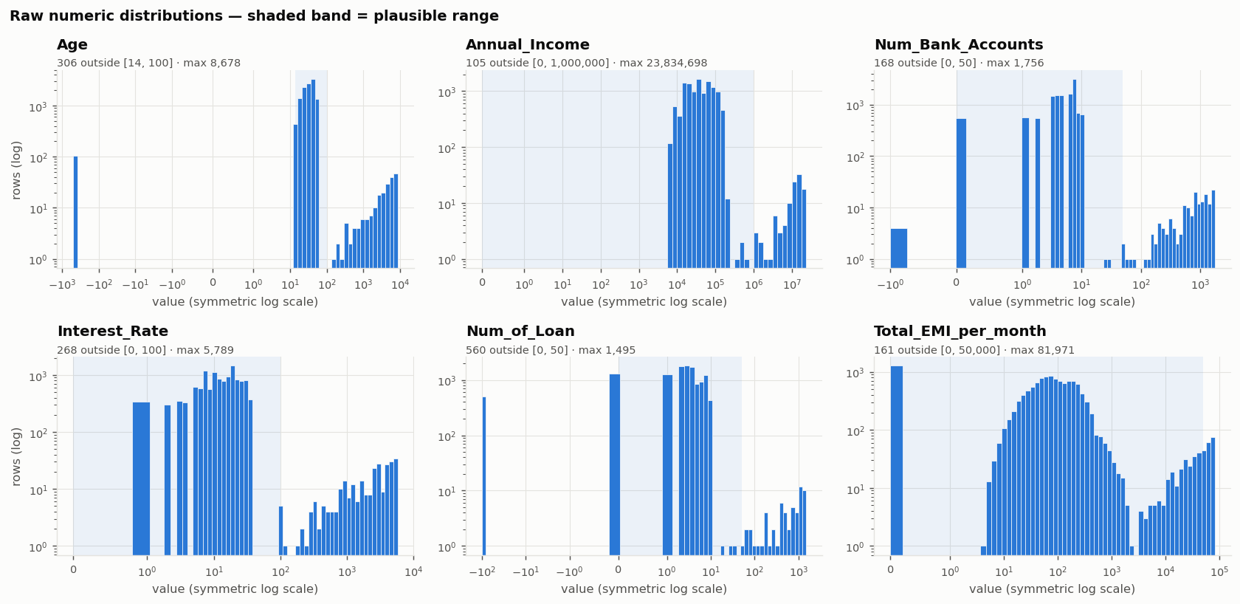
Impossible values form separate clusters: errors
STEP 04
Age −500 to 8,678; 1,756 bank accounts; interest rates up to 5,789%; income up to 23.8M. A gap separates them from the realistic body, which marks errors rather than genuine extremes.
CS611 Assignment 2 · Loan default pipeline · Checklist V6.6 steps 01–23
7
Notes:
Symmetric-log x axis shows negatives in real units; log y axis makes small error clusters visible. Shaded band = plausible range. The gap between the body and the far cluster is the evidence for treating them as invalid (set to null in Silver) rather than capping them.

Slide 8
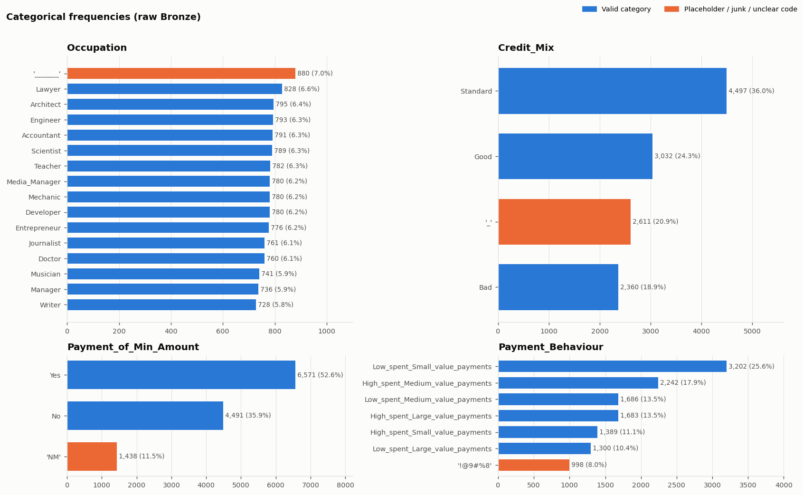
Placeholders, personal data and a coverage gap
STEP 04
Placeholder categories
‘_______’ Occupation 7.0% · ‘_’ Credit_Mix 20.9% · ‘!@9#%8’ Payment_Behaviour 8.0% · ‘NM’ 11.5%
Personal identifiers
Name and SSN flagged as PII. 703 SSNs are the junk value ‘#F%$D@*&8’.
Coverage
Clickstream covers 8,974 of 12,500 loan customers (71.8%). Later this turned out to be a clean time break.
CS611 Assignment 2 · Loan default pipeline · Checklist V6.6 steps 01–23
8
Notes:
Orange bars = placeholder or unclear codes. Personal data never enters Silver or any report (HTML profiles are generated without Name/SSN and without sample rows).

Slide 9
PART 2
Silver data cleaning
Enforce a schema contract, validate, clean with recorded decisions, then prove the cleaning against the raw baseline.
Steps 05–09
CS611 Assignment 2 · Loan default pipeline · Checklist V6.6 steps 01–23
9

Slide 10
Cleaning decisions: null and flag, never guess
STEPS 05–07
Bronze finding | Silver decision | Evidence / reason
Trailing underscores (32_, 52312.68_) | Correct: strip and cast | ~2,600 values recovered
Impossible values (Age 8,678 …) | Null + _invalid flag | Quarantine would lose 22% of loans; impute = leakage
Placeholders and NM | Null + _invalid flag | NM rows mix Yes/No Credit_Mix profiles: not recorded
Empty Type_of_Loan | Means ‘no loans’ | 1,363 of 1,426 empty rows have Num_of_Loan = 0
Negative Delay_from_due_date | Accept | Paid before the due date
Instalment > monthly salary | Null + flag (added after step 08) | 236 rows; others pay ≤ 15% of salary
Name, SSN | Not loaded | Personal identifiers
Keys, dates, ledger invalid | Quarantine row | 0 rows needed it
Step 09 parsing runs before step 08: Credit_History_Age → months; Type_of_Loan → list, count and later 9 loan-type flags. Original text kept for audit.
CS611 Assignment 2 · Loan default pipeline · Checklist V6.6 steps 01–23
10
Notes:
Key debate: null vs quarantine vs cap. Null keeps the row and its other good values; the model imputes later with training-only medians (step 18). Quarantine is reserved for critical fields (keys, dates, label inputs).

Slide 11
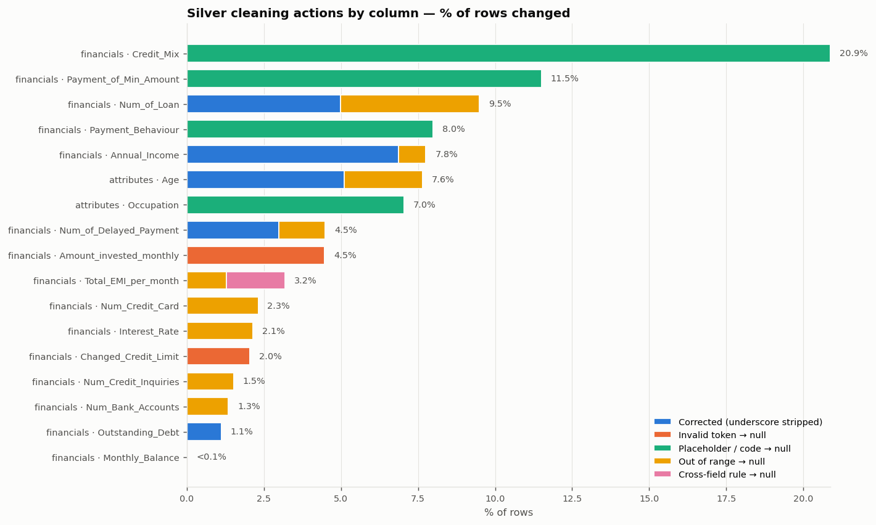
Validation: 14 failures before cleaning, none after
STEPS 06–07
6 remaining WARNs are accepted nulls (placeholders, NM, empty loan text) and the clickstream coverage gap.
No rows lost: 377,876 in, 377,876 out.
CS611 Assignment 2 · Loan default pipeline · Checklist V6.6 steps 01–23
11
Notes:
Rules: keys, null %, ranges, categories, formats, dates, loan-ledger reconciliation, cross-field (instalment vs salary, loan count vs loan list), foreign keys. Same rules run before and after cleaning. Right: what cleaning changed per column.

Slide 12
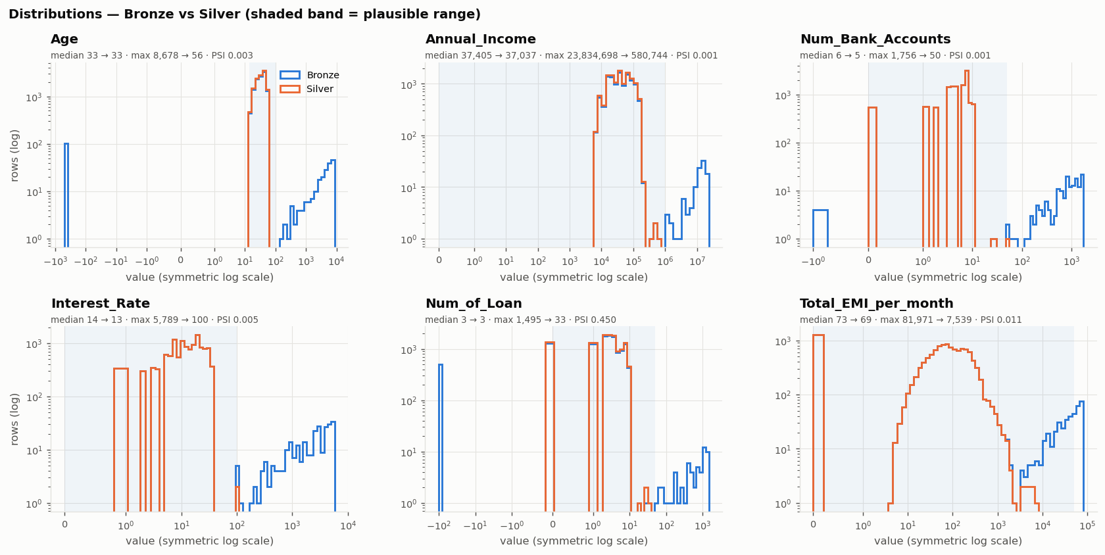
Step 08: typical values kept, error tail removed
STEP 08
Column | Median | Max
Age | 33 → 33 | 8,678 → 56
Interest_Rate | 14 → 13 | 5,789 → 100
Num_Bank_Accounts | 6 → 5 | 1,756 → 50
Num_of_Loan | 3 → 3 | 1,495 → 33
Same profiling function as Bronze: 59 columns compared; 45 unchanged, 14 changed and all explained by a cleaning action. No row loss, no new duplicates.
Valid category shares moved 0.00 pp: only placeholders became null.
CS611 Assignment 2 · Loan default pipeline · Checklist V6.6 steps 01–23
12
Notes:
Blue = Bronze, orange = Silver on identical axes. Where they overlap, cleaning did nothing; only the separate error clusters disappear. PSI caveat: Num_of_Loan PSI 0.45 because removing the -100 code empties one bin, median unchanged.

Slide 13
Step 08 found one more error; all 39 findings decided
STEP 08 · GATE 1
236
loans with a monthly instalment larger than monthly salary (1,689–49,942). For everyone else the instalment is at most 15% of salary.
Fixed limits from step 04 were too loose; a cross-field rule now nulls them.
Gate 1 passed: raw data reproducible, Bronze EDA documented, Silver validated against the raw baseline.
CS611 Assignment 2 · Loan default pipeline · Checklist V6.6 steps 01–23
13
Notes:
The Bronze-vs-Silver distribution overlay revealed a residual cluster for Total_EMI_per_month that the fixed upper bound let through. The decision register links every Bronze issue ID to a decision and a verification test; a test fails if any finding is unmapped.

Slide 14
PART 3
Gold feature store
One row per loan with features as of the loan start date, labels in a separate store, and a release that is blocked unless every acceptance check passes.
Steps 10–13
CS611 Assignment 2 · Loan default pipeline · Checklist V6.6 steps 01–23
14

Slide 15
Separate feature and label stores, joined by loan_id
STEPS 10–12
Silver features
As-of join
Feature store v1
attributes · financials · clickstream (monthly snapshots)
latest snapshot with snapshot_date ≤ loan_start_date
12,500 loans × 68 features, by loan-start month
Silver loan ledger
Label rule
Label store
lms_loan_daily: instalments, overdue, balance
DPD ≥ 30 at month-on-book 6; mature / immature / censored
30dpd_6mob: label, outcome date, DPD, maturity
No label in X by design: labels live only in the label store; the ML pipeline joins them.
Versioned and documented: feature dictionary with type, unit, source, derivation, as-of rule and coverage note per feature.
CS611 Assignment 2 · Loan default pipeline · Checklist V6.6 steps 01–23
15
Notes:
Grain = loan (equals customer here, but loan grain is correct and future-proof). Feature store partitioned by scoring month, label store by outcome month. Contract bumped to v1.1.0 to declare the derived features.

Slide 16
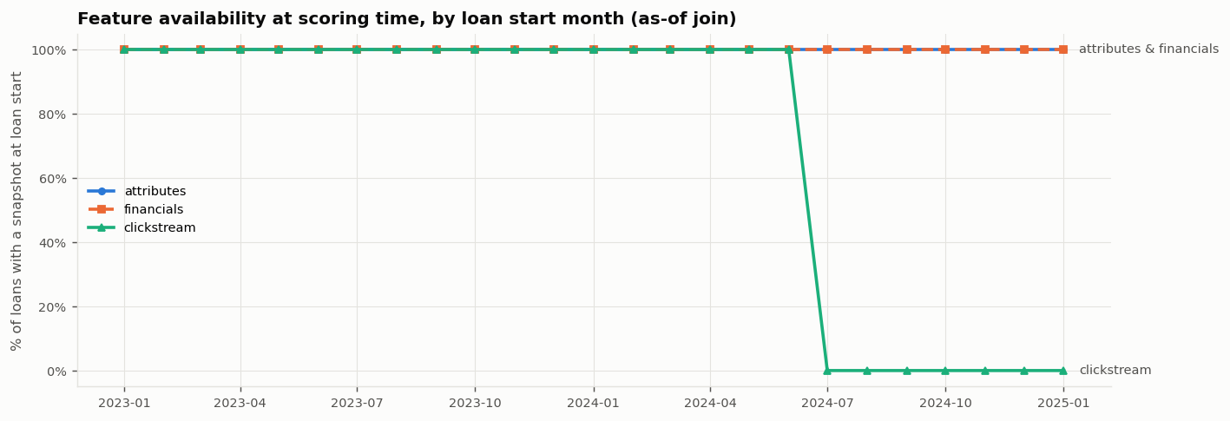
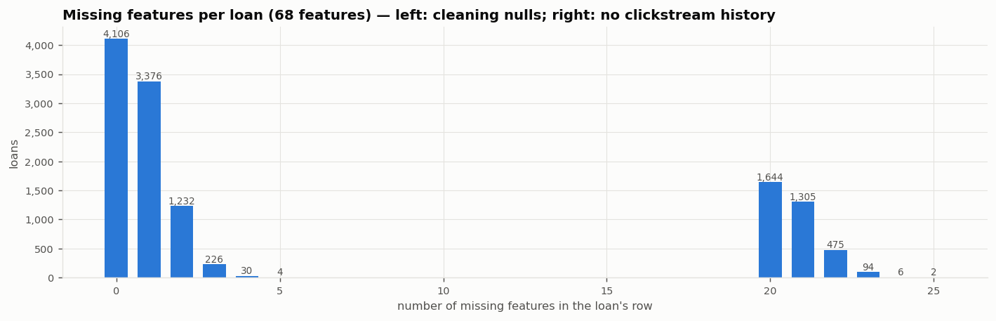
Clickstream stops for every loan from July 2024
STEP 10
Not random: a time break
Loans starting 2023-01 → 2024-06: 100% clickstream. Loans starting 2024-07 → 2025-01: 0%.
A ‘has_clickstream’ flag would be a hidden date: withdrawn.
Plan: model A without clickstream (main) and model B with it (challenger).
Only 32.8% of loans have all features filled.
CS611 Assignment 2 · Loan default pipeline · Checklist V6.6 steps 01–23
16
Notes:
Bottom chart: missing features per loan is bimodal. Left cluster = cleaning nulls (1-5 features); right cluster = no clickstream history (20+ features). 130,468 future-dated clickstream rows were excluded by the as-of join.

Slide 17
Step 13: release only after every check passes
STEPS 11–13
12,500
3,602
28.82%
Historical replay test
Features rebuilt from Silver cut off at three cohorts' start dates match the stored features exactly: no later data leaked in.
loans with a mature label
defaults (positive class)
label rate
Acceptance check (15 in total) | Result
One row per loan, no null keys (both stores) | PASS
Same 12,500 loans: Silver = features = labels | PASS
Features × mature labels joined 1:1, no loss | PASS
Feature snapshot ≤ loan_start_date | PASS (0 rows)
Outcome at loan start + 6 months | PASS
No label or ledger column in the features | PASS
Every predictor allowed by contract v1.1.0 | PASS
Staged release
Stores are written to staging and promoted only after 15/15 checks pass. A failure blocks the release (the checklist's ‘block release on leakage’).
CS611 Assignment 2 · Loan default pipeline · Checklist V6.6 steps 01–23
17
Notes:
Label edge case documented and unit-tested: under the calendar-day DPD convention, one missed instalment over February gives 29 days (label 0). No such loan exists here: the minimum at MOB 6 is two missed instalments.

Slide 18
PART 4
Bronze, Silver, Gold EDA to findings
Freeze the holdout first, analyse feature–target relationships on training data only, check time quality, and turn every finding into an action.
Steps 14–17
CS611 Assignment 2 · Loan default pipeline · Checklist V6.6 steps 01–23
18

Slide 19
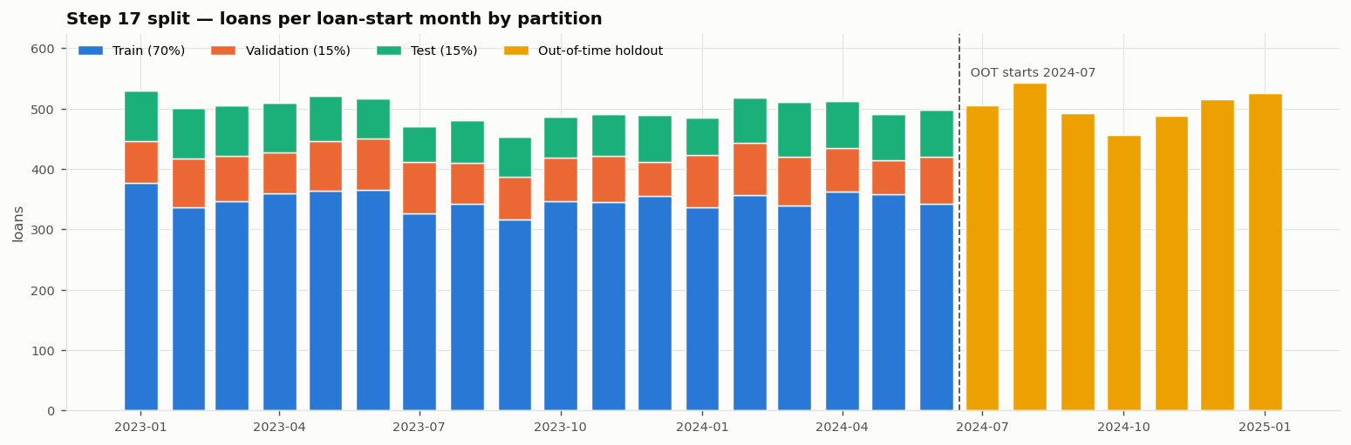
Step 14: the holdout is frozen before any label analysis
STEP 14
Partition | Loan start | Loans | Label rate
Train (70%) | 2023-01 → 2024-06 | 6,281 | 28.86%
Validation (15%) | 2023-01 → 2024-06 | 1,346 | 28.90%
Test (15%) | 2023-01 → 2024-06 | 1,347 | 28.88%
Out-of-time holdout | 2024-07 → 2025-01 | 3,526 | 28.67%
Stratified random split inside development; out-of-time = later cohorts.
Checks: no customer or date overlap; reproducible (seed 42).
Accepted WARN: training outcomes overlap the OOT start by 6 months.
CS611 Assignment 2 · Loan default pipeline · Checklist V6.6 steps 01–23
19
Notes:
Why not a purely random split: the model scores future applicants, so the honest final estimate must come from later loans (out-of-time). In-time test vs out-of-time shows drift. Also note: OOT has no clickstream, so model A is the one evaluated there.

Slide 20
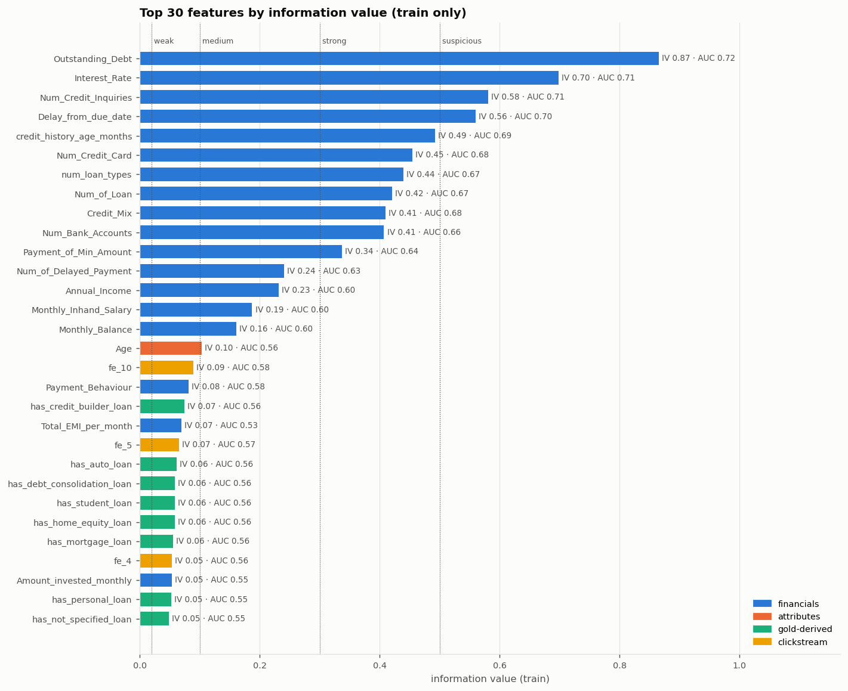
Step 15: financial history drives default
STEP 15
Feature group | Mean IV | Read
Financials | 0.19 | medium–strong
Gold loan-type flags | 0.06 | weak
Attributes | 0.03 | weak
Clickstream | 0.02 | near useless
Strongest: Outstanding_Debt (IV 0.87), Interest_Rate, Num_Credit_Inquiries, Delay_from_due_date, credit history length.
‘Suspicious’ IV > 0.5 accepted: AUC only 0.70–0.72 and known at application; classic credit drivers, not leakage.
Training data only: 6,281 loans; a code guard asserts it.
CS611 Assignment 2 · Loan default pipeline · Checklist V6.6 steps 01–23
20
Notes:
Information value: <0.02 not useful, 0.02-0.1 weak, 0.1-0.3 medium, 0.3-0.5 strong, >0.5 suspicious. Real leakage usually shows univariate AUC above 0.9; here the strongest is 0.73.

Slide 21
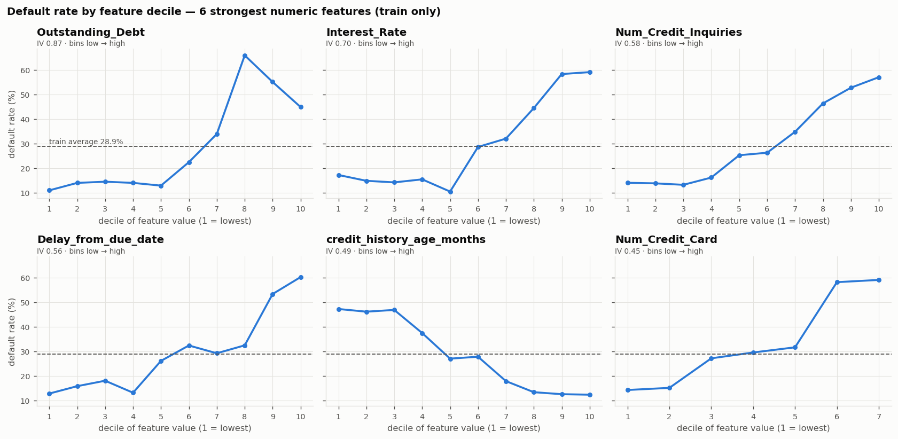
Default rate climbs steeply with debt, rate and delays
STEP 15
Outstanding_Debt is not monotonic (peaks at decile 8, ~66%): trees handle this natively; the linear model gets a quantile transform. Longer credit history means less default (47% → 12%).
CS611 Assignment 2 · Loan default pipeline · Checklist V6.6 steps 01–23
21
Notes:
Default rate by decile of each feature, training data only; dashed line = training average 28.9%.

Slide 22
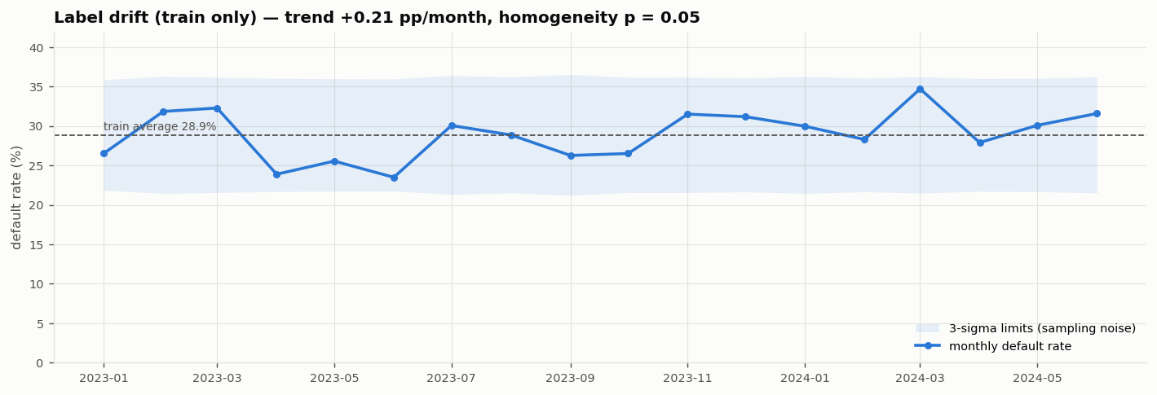
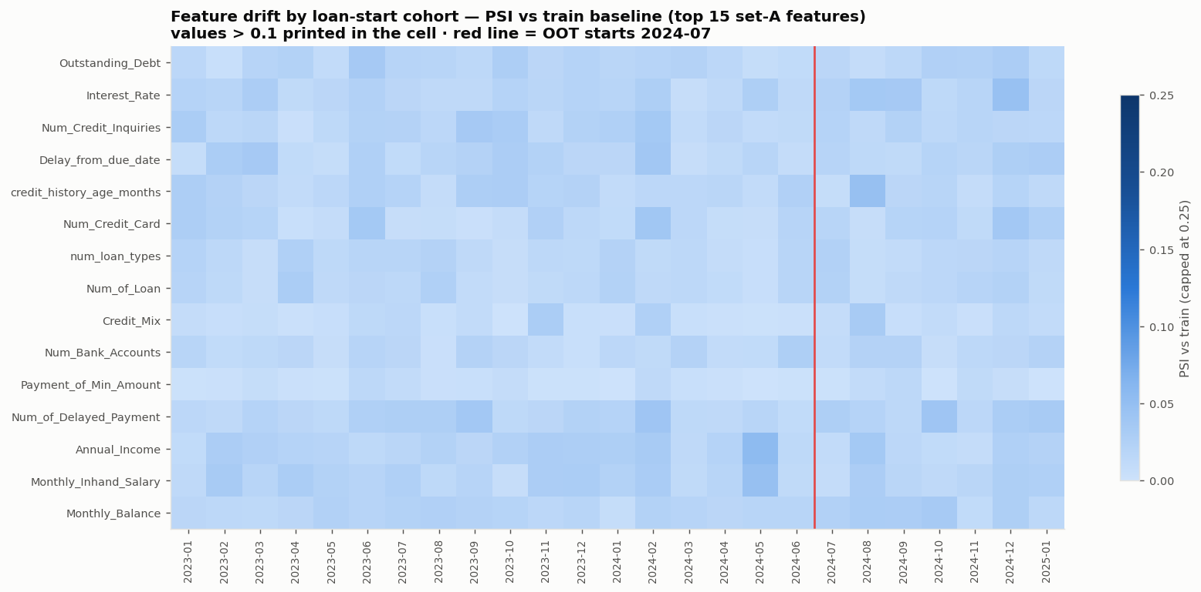
Step 17: stable over time, except clickstream
STEP 17
Check | Result
Missing periods | None
Feature drift (train) | PSI ≤ 0.016
Dev vs OOT (info) | PSI ≤ 0.007
Label drift | Within limits
Seasonality | Not assessable
Look-ahead | Tested
Monthly default rate 23.5–34.7%, all inside sampling-noise limits.
Dev-vs-OOT drift uses features only and never drives decisions.
CS611 Assignment 2 · Loan default pipeline · Checklist V6.6 steps 01–23
22
Notes:
PSI below 0.1 = stable. The control chart shows each month's default rate against 3-sigma sampling limits (train only). Slight upward trend of +0.21 pp per month; chi-square homogeneity p = 0.048.

Slide 23
Step 16: 56 findings, none left open before modelling
STEP 16 · GATE 2
Assigned to | Action
Step 18 | Keep missing indicators where missingness predicts default
Step 23 | Drop 2 constant flags; keep one of 2 near-duplicate pairs
Step 25 | Compare model A (no clickstream) vs model B
Step 27 | Re-check the 4 strong financial features
Gate 2 passed: Gold grain and time rules verified, split frozen, findings tracked.
Each finding carries an owner, rationale, verification and status.
Accepted = documented exceptions (e.g. freshness, clickstream break).
CS611 Assignment 2 · Loan default pipeline · Checklist V6.6 steps 01–23
23
Notes:
The register consolidates Bronze, Silver and Gold findings: 34 closed (done and verified), 13 accepted with rationale, 9 assigned to a named later step. Gate 2 requires nothing open.

Slide 24
PART 5
Feature engineering (AutoFE)
Automated feature search on training data only, model-specific filtering with documented validation impact, and preprocessing that is fitted once and never refitted.
Steps 18–23
CS611 Assignment 2 · Loan default pipeline · Checklist V6.6 steps 01–23
24

Slide 25
Step 21: OpenFE searched 918 candidates in 8 seconds
STEPS 19–22
918
856
20
100%
row-wise candidates
ranked by OpenFE
kept
re-implemented
pairs of 18 numeric model-A features: + − × ÷ min max
LightGBM gain, training data only
after removing 3 duplicate formulas
own formulas match OpenFE; inference needs no OpenFE
Choice | Why
Step 19 (manual ratios) skipped | Replaced by the automated search; manual ratios were the fallback
Row-wise operators only | OpenFE's group-by / frequency operators use train and test together: leakage
Training rows only (6,281) | OpenFE uses the label to rank features
Steps 20 and 22 not applied | Clickstream weak and missing after 2024-06; not a time-series problem
CS611 Assignment 2 · Loan default pipeline · Checklist V6.6 steps 01–23
25
Notes:
Tool choice: OpenFE (flat tabular interactions) over Featuretools (relational DFS) because after Gold there is one row per loan. Technical issue: OpenFE 0.0.12 crashes with LightGBM 4.x; pinned LightGBM 3.3.5.

Slide 26
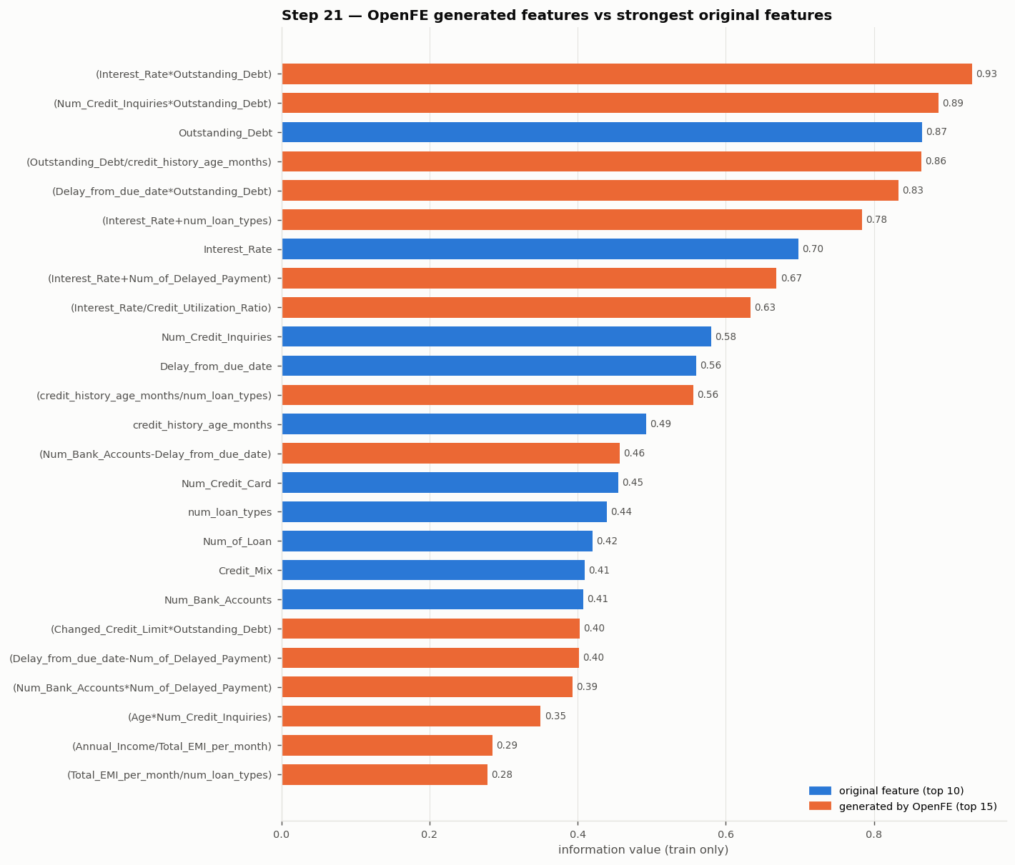
Generated features combine the strongest drivers
STEP 21
Generated feature | IV | Gain
Interest_Rate × Outstanding_Debt | 0.93 | +0.07
Num_Credit_Inquiries × Outstanding_Debt | 0.89 | +0.02
credit_history_months ÷ num_loan_types | 0.56 | +0.07
Annual_Income ÷ Total_EMI_per_month | 0.29 | +0.05
Gains over the best input are small: OpenFE ranks by value alongside the other features, not alone.
Division by zero gives null (e.g. ÷ num_loan_types when a customer has no loans).
Whether they help is tested against the raw-only baseline in steps 25 and 28.
CS611 Assignment 2 · Loan default pipeline · Checklist V6.6 steps 01–23
26
Notes:
Orange bars = generated, blue = original. The definition catalog records formula, inputs, operator, zero-denominator rule and training IV/AUC for each generated feature.

Slide 27
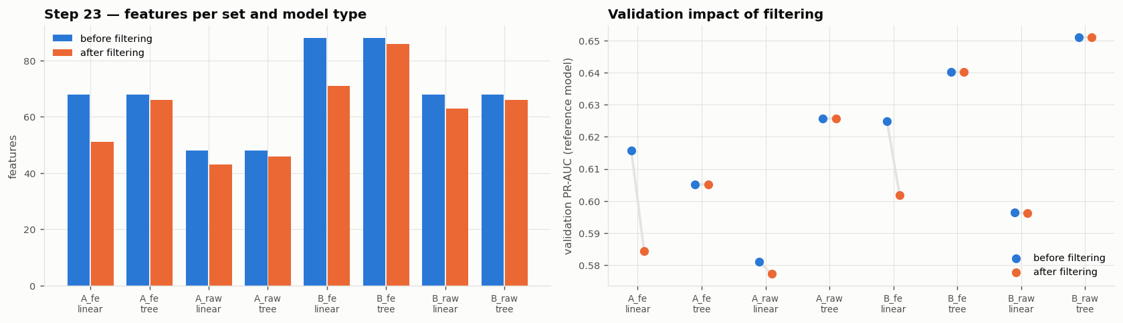
Step 23: flag everything, drop by model type
STEP 23
Feature set | Tree | Linear
A_raw (raw-only baseline) | 46 | 43
A_fe (+ generated) | 66 | 51
B_raw (+ clickstream) | 66 | 63
B_fe (+ both) | 86 | 71
Flags: 2 constant, 11 near-duplicates, 21 VIF > 10; ACF not applicable.
Trees keep correlated features; linear drops near-duplicates and high VIF.
Cost: linear on generated sets −0.02 to −0.03 PR-AUC; documented.
CS611 Assignment 2 · Loan default pipeline · Checklist V6.6 steps 01–23
27
Notes:
V6.6 asks to flag rather than blindly drop and to document validation impact. Reference models trained on train and scored on validation only. Early signal, not a decision: generated features don't help the tree model (A_fe 0.605 vs A_raw 0.626), clickstream may help in-time (B_raw 0.651).

Slide 28
Step 18: a fitted preprocessor per set and model
STEP 18 · GATE 3
Column type | Tree variant | Linear variant
Numeric with _invalid flag | Median impute | + quantile → normal
Other numeric | Median + missing indicator | + quantile → normal
Categorical | ‘Missing’ category + one-hot | same
0/1 flags | Passthrough | same
Unseen category | All zeros, no error | same
Fit / transform tests (all 8 pass)
Medians are training medians · validation, test and OOT never refit · unseen categories and new missing values handled · no nulls · same columns everywhere · deterministic.
Gate 3 passed: time-safe features, train-only transformations and filtering, no holdout leakage.
Inference path: apply generated-feature formulas → preprocessor.transform → model.
8
3/3
saved preprocessors
gates passed
CS611 Assignment 2 · Loan default pipeline · Checklist V6.6 steps 01–23
28
Notes:
No duplicate indicators: features that already carry an _invalid flag from Silver don't get a second missing indicator. Example of no-refit evidence: Outstanding_Debt train median 1169.20 is used everywhere; validation median would be 1161.06.

Slide 29
Key takeaways and next steps
Trustworthy data
Leakage-safe by design
Raw kept as-is; every cleaning decision recorded and verified against the raw baseline.
Contract, as-of joins, separate label store, frozen holdout, train-only fitting, tests.
Evidence over assumptions
Ready for modelling
Overlays and cohort charts exposed the instalment errors and the clickstream time break.
4 feature sets × 2 model types, fitted preprocessors, raw-only baseline preserved.
NEXT: STEPS 24–30
Baseline (dummy + logistic regression on A_raw) · model comparison A vs B, raw vs generated · imbalance and threshold · SHAP · feature reduction · tuning · sign-off before the out-of-time test
CS611 Assignment 2 · Loan default pipeline · Checklist V6.6 steps 01–23
29
Notes:
Close with the four takeaways and the plan for section 04. Primary metric proposed: PR-AUC (defaults are 29% of loans), with ROC-AUC, recall and precision as secondary metrics.

